Slide 1
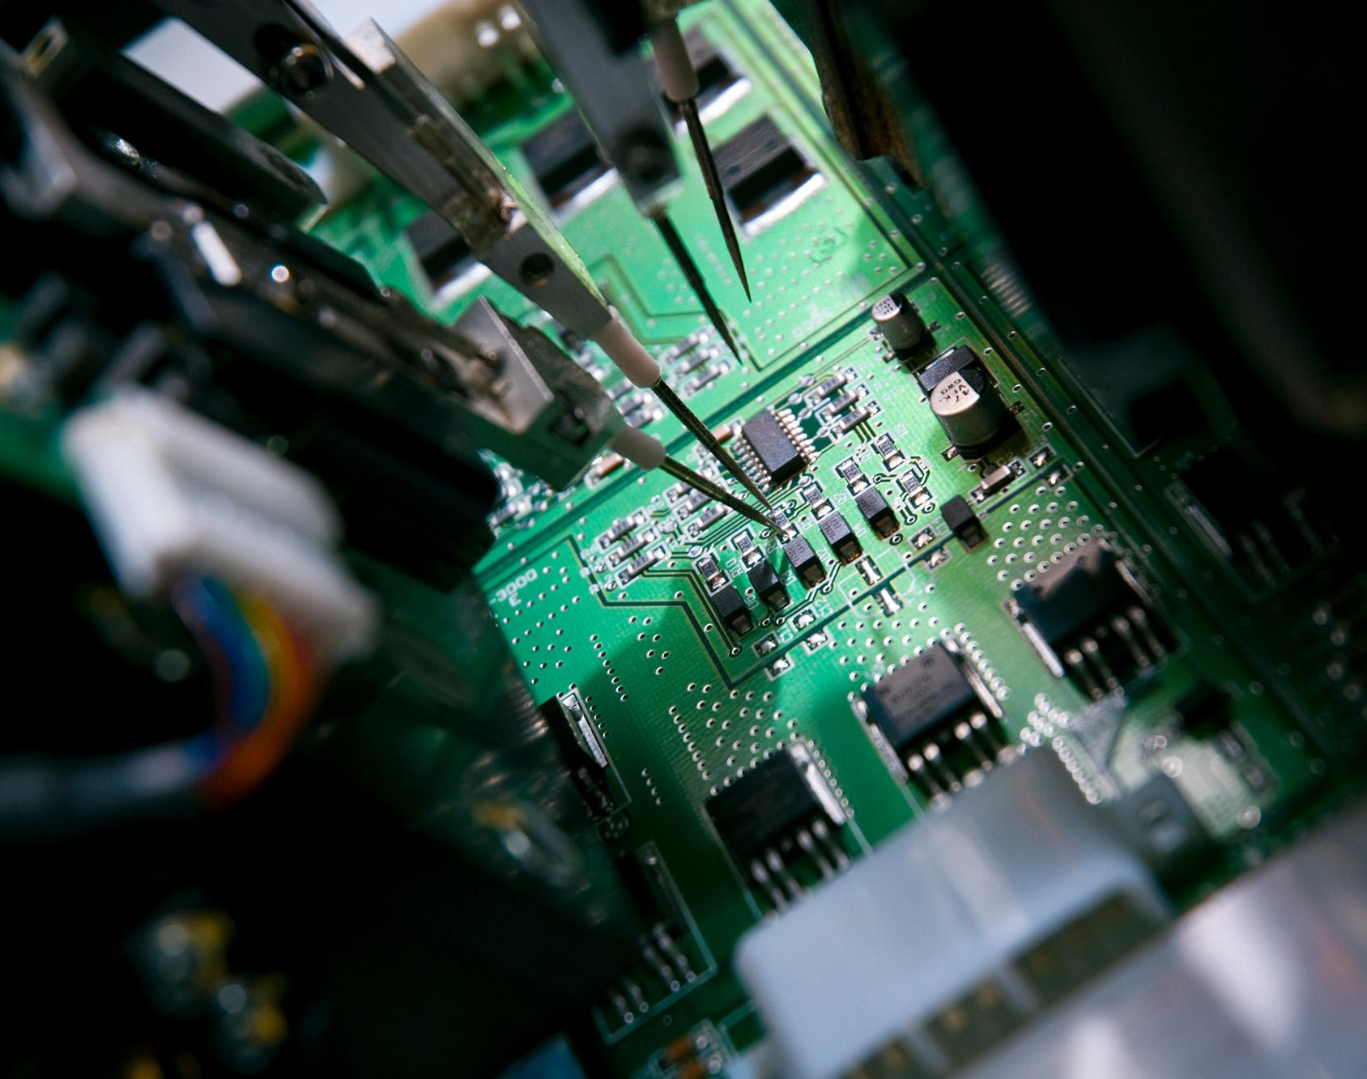
Enhancing Quality and Efficiency in Copper Clad Laminate Manufacturing: A Data-Driven Approach
Team 1: Timothy Liu, Zerek Leyva, Jeet Khut, Joshua Downing, Suk Ki Lee
Notes:
Good morning, everyone.
We are Team 1, and my name is @@@.
Today, I will present our data-driven approach to enhancing quality and efficiency in Copper Clad Laminate manufacturing.
Our team consists of Timothy Liu, Zerek Leyva, Jeet Khut, Joshua Downing, and Suk Ki Lee.
The data for this project comes directly from ISOLA's production line, where our teammate Joshua works, ensuring our analysis is grounded in real-world manufacturing scenarios.
Let’s begin!
(30s)

Slide 2
Introduction
Significance of CCLs in PCB Production:
Copper Clad Laminates (CCLs) provide structural and conductive bases for Printed Circuit Boards (PCBs).
Challenges in CCL Manufacturing:
The rejection rate of 1.29%, significantly exceeds the manufacturers target of 0.5%, due to defects like:
Voids and Bubbles as a result of poor resin distribution or trapped air.
Delamination caused by inadequate adhesion or improper curing.
High-Potential (Hi-Pot) Failures: Indicate weak dielectric strength and insulation inconsistencies.
These issues not only increase production costs but also threaten the structural integrity and functionality of electronic devices, impacting customer satisfaction and the manufacturer's reputation.
Notes:
Copper Clad Laminates, or CCLs, are critical in printed circuit board manufacturing, serving as the foundation for electronic devices.
However, the rejection rate of 1.29% far exceeds the industry target of 0.5%, driven by defects like voids, bubbles, delamination, and Hi-Pot failures.
These defects increase costs and threaten product reliability, emphasizing the need for improvements in manufacturing quality.
(30s)

Slide 3
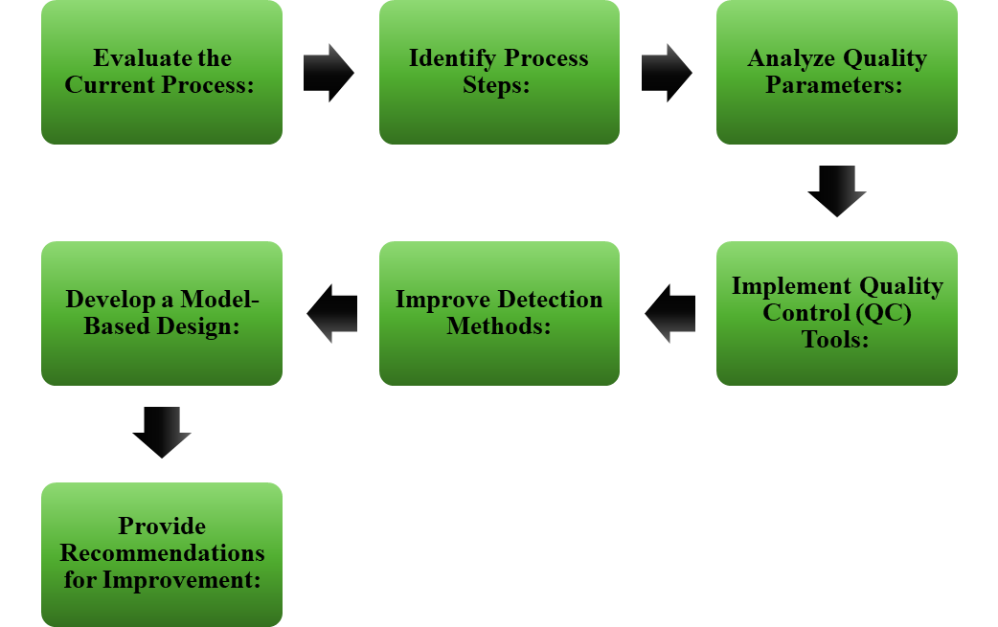
Problem Statement
Challenges
- High rejection rate of 1.29% due to defects:
∙ Hi-Pot failures (38.56%)
∙ Surface defects (35.37%)
∙ Voids (19.56%)
∙ Foreign material (6.51%)
- Causes include environmental contamination,
process inefficiencies, and weak process controls.
Primary Objectives
- To decrease these basic causes by following
a structured improvement process
Notes:
As mentioned earlier, the copper-clad laminate manufacturing process struggles with a rejection rate of 1.29%, primarily due to defects like Hi-Pot failures, surface defects, voids, and contamination by foreign materials.
These issues stem from inefficiencies in the process and weak controls, leading to increased costs and reduced customer satisfaction.
Our primary objective is to address these root causes using a structured improvement process.
As shown in the diagram, this process involves evaluating the current manufacturing steps, analyzing quality parameters, implementing quality control tools, improving detection methods, and ultimately developing a model-based design.
This approach will enable us to provide effective recommendations for improvement.
(1min)

Slide 4
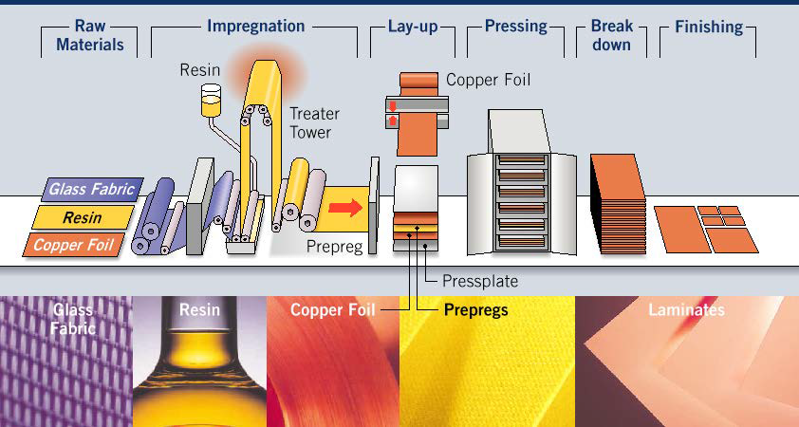
Process Overview
Manufacturing Steps
Compounding: Mixing resin and additives.
Impregnation: Coating fiberglass with resin.
Ply-Up: Sheeting prepreg rolls.
Lay-Up: Stacking prepreg sheets with
copper foil.
Pressing: Curing layers under heat and pressure.
Break-Down: Separating laminates from carriers.
Finishing: Cutting, inspection, and packaging.
Notes:
The copper-clad laminate manufacturing process involves several critical steps to ensure product quality and functionality.
The process begins with compounding, where resin and additives are mixed, followed by impregnation, where fiberglass is coated with resin.
Next is ply-up, preparing resin-coated rolls for lay-up, where sheets are stacked with copper foil.
The pressing stage then cures the layers under heat and pressure to form laminates.
Afterward, the break-down stage separates laminates from their carriers, and finally, finishing includes cutting, inspection, and packaging.
(45s)

Slide 5
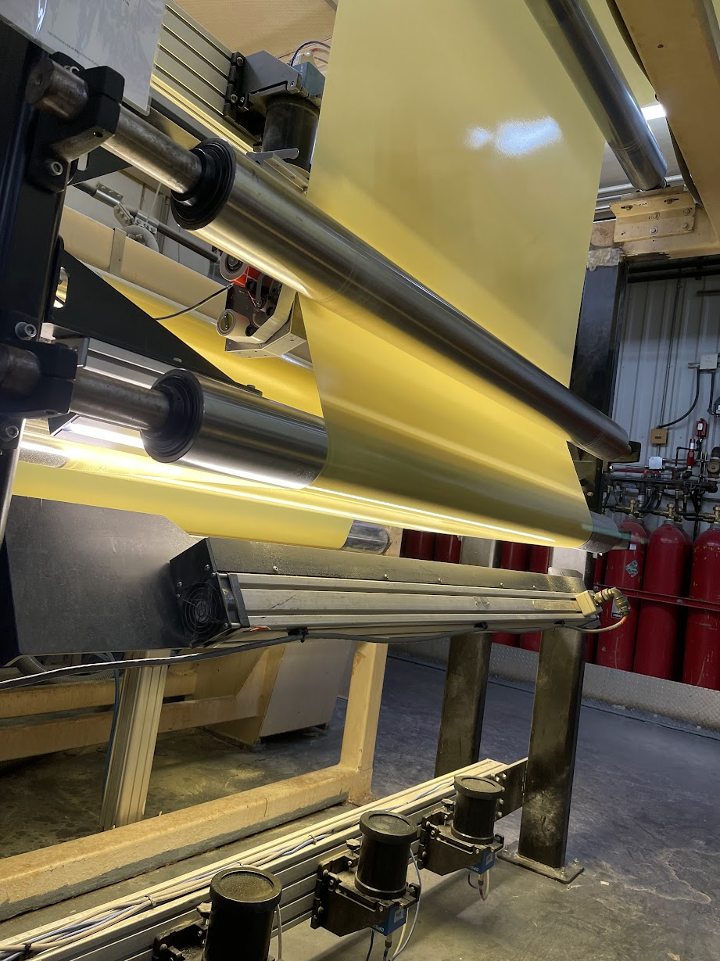
Data Collection and Quality Control Tools
Data is collected and analyzed using quality control tools tailored to detect inefficiencies and defects at each stage
Compounding & Impregnation
- Rheometer: Monitors minimum melt viscosity and gelation time.
- Automated Optical Inspection (AOI): Detects resin inconsistencies.
- Laboratory Scales & Micrometers: Measure resin content and treated thickness.
Ply-Up & Lay-Up
- Digital Checksheets (SAP): Track process consistency.
- Automated Systems: Ensure accurate layer stacking.
Pressing
- Press Cycle Records: Monitor temperature, pressure, and vacuum profiles.
- Thermocouples: Track curing consistency.
Break-Down & Finishing
- Hi-Pot Testing Machine: Detect insulation inconsistencies.
- Visual Inspections: Validate structural integrity.
These tools not only ensure process control but also provide actionable data for real-time monitoring and long-term improvements.
Notes:
Data collection and quality control are essential for ensuring consistency and detecting inefficiencies in CCL manufacturing.
Each stage of the process utilizes tailored tools to monitor key parameters and gather actionable data.
In the compounding and impregnation stage, tools like rheometers measure minimum melt viscosity and gelation time, while automated optical inspection, or AOI, detects resin inconsistencies.
Laboratory scales and micrometers are used to measure resin content and treated thickness.
During ply-up and lay-up, digital checksheets ensure process consistency and automated systems support accurate layer stacking.
In the pressing stage, press cycle records and thermocouples monitor critical variables like temperature, pressure, and curing consistency.
Finally, in the break-down and finishing stage, Hi-Pot testing machines detect insulation issues, while visual inspections validate structural integrity.
Together, these tools not only ensure real-time process control but also provide valuable insights for long-term improvements.
(1min 15s)

Slide 6
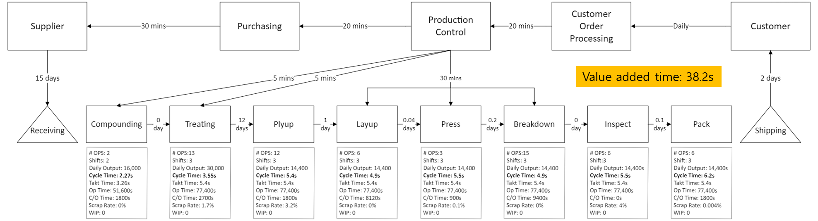
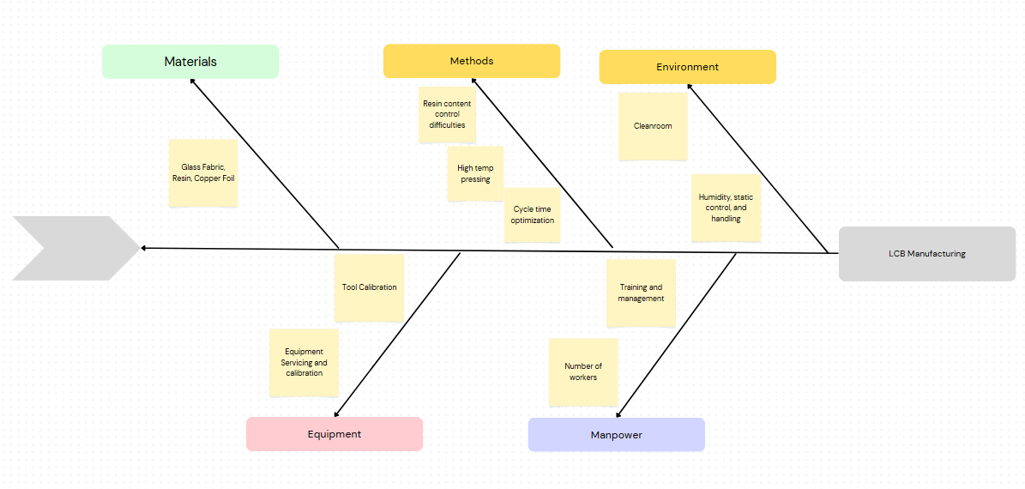
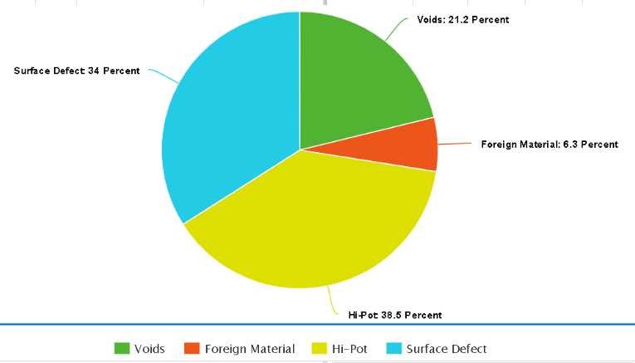
Data Analysis and Insights
Flow Chart Value-Added Analysis:
Breakdown of process steps into value-added and non-value-added time.
Highlight inefficiencies, e.g., delays in receiving and post-treating stages.
Fishbone Diagram:
Root cause analysis for major defects like Hi-Pot failures and surface inconsistencies.
Pareto Analysis (Pie Graph):
Visualization of defect contributions:
Hi-Pot failures: 38.56%
Surface defects: 35.37%
Voids: 19.56%
Foreign material: 6.51%
Notes:
We conducted a detailed analysis to identify inefficiencies and prioritize improvements.
Our value-added analysis revealed significant delays in the receiving and post-treating stages, contributing to non-value-added time in the production process.
To further investigate defects, we used a fishbone diagram for root cause analysis, focusing on factors like curing consistency, resin distribution, and contamination.
A Pareto analysis highlighted that Hi-Pot failures and surface defects accounted for over 70% of the rejection rate, emphasizing the need to address these issues first.
(1min)

Slide 7
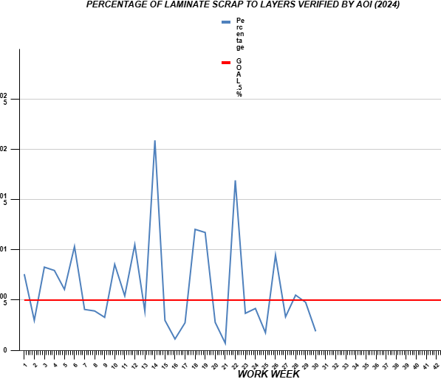
Recommendations and Outcomes
Recommendations:
Streamline material handling processes.
Adopt just-in-time inventory systems.
Implement real-time monitoring systems.
Continue refining defect detection methods.
Outcomes and Findings:
Enhanced resin curing profiles and cleanliness.
Positive trends in defect prevention strategies after Week 23.
Progress toward achieving the 0.5% scrap rate goal.
Identified areas for further refinement in curing consistency.
Notes:
Our recommendations focus on streamlining material handling, adopting just-in-time inventory systems, and implementing real-time monitoring tools.
These steps will refine defect detection and improve efficiency.
Through our efforts, we’ve seen enhanced resin curing profiles and improved cleanliness, leading to positive trends in defect prevention strategies, particularly after Week 23.
While progress has been made toward the 0.5% scrap rate goal, areas like curing consistency still require further refinement.
(1min)

Slide 8
Conclusion
Summary of Objectives and Achievements
Addressed challenges in CCL manufacturing through data-driven insights.
Focused on defect identification, process optimization, and quality improvement.
Implemented advanced statistical and quality control tools.
Future Steps
Continued monitoring and refinement of defect detection systems.
Process optimization to meet and sustain the 0.5% rejection rate goal.
Notes:
In conclusion, we tackled key challenges in CCL manufacturing by leveraging data-driven insights and advanced quality control tools.
Our efforts focused on identifying defects, optimizing processes, and improving overall quality.
Through these strategies, we’ve made significant progress toward reducing defect rates and enhancing efficiency.
Looking forward, continued monitoring and refinement of defect detection systems, along with ongoing process optimization, will be critical to achieving and sustaining the 0.5% rejection rate goal.
These steps will ensure long-term improvements in product quality and operational efficiency
(30s)

Slide 9

Questions?

